Slide 2
Physics 123

Slide 3
Question 6.11
I have a mass on a spring undergoing simple harmonic motion. The amplitude is 5m. The frequency is 2Hz. The phase is 0 degrees. When the time is t=2sec, what is the distance the mass will be from the equilibrium point.
5m
-5m
2.5m
0m

Slide 4
Problem
Usually, we need to know how we start our oscillator to solve a problem. Let's see how this works. Suppose we start the motion of a mass attached to a spring (a harmonic oscillator) by pulling the mass to x=x_{max} and releasing it at t=0. Find the phase.
m
x = 0
x_{max}

Slide 5
Problem
Using the same equipment as in the last problem, let's start with x(0) = 0 v(0) = v_{i}
that is, the mover mass is already moving when we start our experiment, and we start watching just as it passes the equilibrium point. Once again find the phase.
v_{i}
m
x = 0
x_{max}

Slide 6
Problem
A particle moving along the x-axis in simple harmonic motion starts from its equilibrium position, the origin, at t=0 and moves to the right. The amplitude of its motion is 2.00cm , and the frequency is 1.50Hz .
a) show that the position of the particle is given by
x=(2.00cm )sin(3.00πt)
determine
b) the maximum speed and the earliest time (t>0) at which the particle has this speed,
c) the maximum acceleration and the earliest time (t>0) at which the particle has this acceleration, and
d) the total distance traveled between t=0 and t=1.00s

Slide 7
Lecture 2

Slide 8
Problem
Using energy techniques, find the maximum velocity of the mass in terms of the Amplitude and the angular frequency.

Slide 9
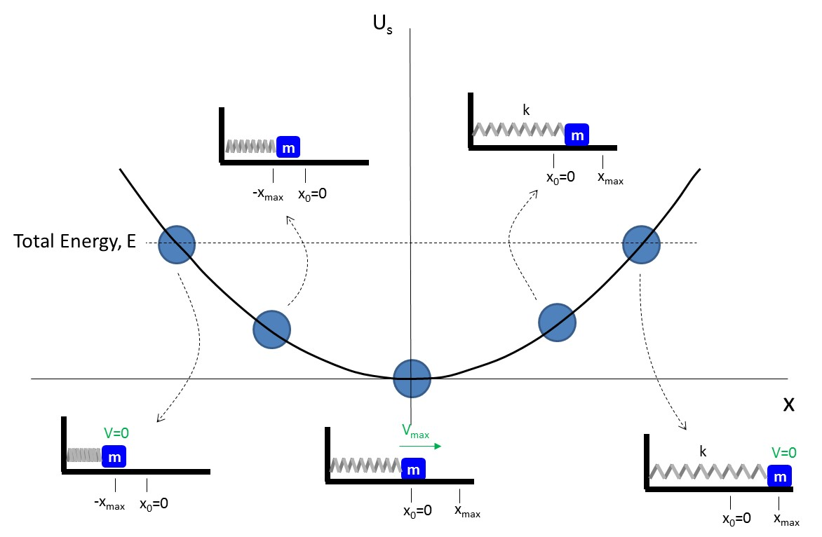
_{s}
k
m
m
x₀=0
x_{max}
-x_{max}
x₀=0
Total Energy, E
x
V=0
V_{max}
m
k
V=0
m
m
-x_{max}
x₀=0
x₀=0
x_{max}
x₀=0
x_{max}

Slide 10
Question 123.2.1
A mass-spring system is experiencing SHM. At a time, t, it has its maximum value of kinetic energy. At t, its potential energy due to the spring is
Positive
Zero
Negative
Positive but decreasing
Negative but increasing
m
x=0
x_{max}

Slide 11
Question 123.2.2
The amplitude of a SHO doubles, its total mechanical energy
Quadruples
Decreases
Doubles
Varies as a function of time
Insufficient information to tell

Slide 12
Question 123.2.3
The spring of a spring-mass SHM system has a spring constant of k. If I replace the spring with a new one that has a spring constant of k/2 but leave everything else the same, the total mechanical energy
Quadruples
Doubles
Is half the original value
Insufficient information to tell

Slide 13
Question 123.2.4
I have an ideal SHO oscillating with a maximum Kinetic energy of 5J. If there is no damping (no frictional forces), then how much total mechanical energy will I have five minutes from now?
5J
4J
2.567J
0J

Slide 14
Question 123.2.5
What is the restoring force in a mass-spring system
F=ma
F=-k(x-x_{e})
F=ΣF
F=-mg

Slide 15
Question 123.2.7
A mass on a spring in SHM has amplitude A and period T. At what point in the motion is v = 0 and a = 0 simultaneously?
x = A
x > 0 but x < A
x = 0
x < 0
none of the above

Slide 16
Question 123.2.8
A spring can be stretched a distance of 60 cm with an applied force of 1 N. If an identical spring is connected in parallel with the first spring, and both are pulled together, how much force will be required to stretch this parallel combination a distance of 60 cm?
1/4 N
1/2 N
1 N
2 N
4 N

Slide 17
Question 123.2.9
A hole is drilled through the center of Earth and emerges on the other side. You jump into the hole. What happens to you?
you fall to the center and stop
you go all the way through and continue off into space
you fall to the other side of Earth and then return
you won’t fall at all

Slide 18
Question 123.2.9 (revised)
A hole is drilled through the center of Earth and emerges on the other side. You jump into the hole. What happens to you?
you fall to the center and stop
you go all the way through and continue off into space
you fall to the other side of Earth and then return
you won’t fall at all
I am a geology major, so I know that the Earth has a high pressure center that will liquefy and flow into the hole because the hole is at a lower pressure, so this is not possible… So what happens is the guy jumps into the hole, accelerates until he hits the magma, and is burned to a cinder

Slide 19
Kinetic Energy
Recall that Kinetic energy can be written as
For SHM

Slide 20
Potential Energy
Recall that potential energy of a spring is
Then for SHM

Slide 21
a_{max}
k
V=0
m
y = 0
x=0
x_{max}

Slide 22
a_{max}
V=0
m
y = 0
-x_{max}
x=0

Slide 23
Total Mechanical Energy
This is an astounding result!
The total mechanical energy of a SHO is a constant of motion

Slide 24
U
K
V=0
U
K
m
U
K
V
-x_{max}
V
x=0
m
m
x=0
x=0
V_{max}
V_{max}
m
m
U
K
U
K
x=0
x_{max}
x_{max}
x=0
k
V
k
V
After Halliday and Resnick Figure 35-1
m
m
k
V=0
U
K
x=0
x_{max}
m
x=0
U
K
x=0
x_{max}
U
K

Slide 25
Energy as a function of time
Note that the kinetic and potential energy are out of phase with each other.
If we plot them on the same scale ( for the case φ=0) we have
U
K
U,K

Slide 26
SHM Restoring Force
Hook’s Law
(Hook’s strong suggestion)
Force is directed toward equilibrium point
Then the acceleration is given by
Equilibrium Position
F_{s}
m
x=0
x_{max}
m
x=0
x_{max}
F_{s}
m
For SHM the acceleration is proportional to the position and is oppositely directed
-x_{max}
x=0

Slide 27
SHM Acceleration
The acceleration of the mass experiencing SHM is
zero at equilibrium,
maximum at the extreme displacement
a=0
m
x=0
x_{max}
k
-a_{max}
a_{max}
m
m
x=0
x_{max}
-x_{max}
x=0
a=0
m
x=0
x_{max}

Slide 28
Start with a horizontal block-spring System
m
Recall the relationships between position, velocity, and acceleration
Then in the x-direction
Ignore all but the x direction
x=0
x_{max}
We define a convenient quantity
And we have
Which is a lovely differential equation!

Slide 29
Solutions to the DEQ
The differential equation needs a solution that is the negative of its own second derivative
From calculus we know a few of these
Take the cosine function
These might be solutions, but we need to find A, φ, ω

Slide 30
The Solution!
Let's substitute these expressions into our differential equation for the motion
So as long as the quantity ω in the cosine function is the same as our convenient quantity
We have a solution

Slide 31
Solution Properties
From Trigonometry we can identify ω as the angular frequency
and φ as the phase angle
We also recognize A as the amplitude
We need values for these last two quantities to complete our solution

Slide 32
Period and Frequency
The period is the time it takes for the mass to travel through one complete cycle
We know from trig that the period and frequency are related
We can write both in terms of the SHO constants

Slide 33
Question 123.2.6
The spring of a spring-mass SHM system has a spring constant of k. If I replace the spring with a new one that has a spring constant of k/4 the frequency
Quadruples
Doubles
Is half the original value
Insufficient information to tell

Slide 34
Velocity and Acceleration
We find the velocity as a function of time by taking the derivative of our solution
The amplitude is found by recalling that the maximum value of a sine function is 1
We continue taking derivatives
Again, cosine has a maximum of 1 so

Slide 35
SHM Acceleration
The acceleration of the mass experiencing SHM is
zero at equilibrium,
maximum at the extreme displacement
a=0
m
x=0
x_{max}
k
-a_{max}
a_{max}
m
m
x=0
x_{max}
-x_{max}
x=0
a=0
m
x=0
x_{max}

Slide 36
SHM Velocity
The velocity of the mass experiencing SHM is
maximum at equilibrium,
Zero at the extreme displacement
A
m
x=0
x_{max}
k
V=0
V=0
m
m
x=0
x_{max}
-x_{max}
x=0
V_{max}
m
x=0
x_{max}

Slide 37
a=0
V_{max}
m
x=0
x_{max}
a_{max}
a_{max}
k
V=0
V=0
m
m
-x_{max}
x=0
x_{max}
x=0
a=0
V_{max}
m
x=0
x_{max}

Slide 38
Hanging Springs
We want to use the same formulas whether the spring is horizontal or hanging
Start with a spring hanging with no weight
Call its end position x_{se} (for spring equilibrium)
Add a weight, the spring stretches from this first equilibrium position (x_{se}) by an amount Δx to a new equilibrium point, x_{me}
How big is Δx?
We then allow the system to oscillate about the new equilibrium
m
m
The forces are
Where the spring force is reduced because the weight is doing some of the stretching (not part of SHM)

Slide 39
Comparison of position, velocity, acceleration
Red is the displacement, green is the velocity, and blue is the acceleration
Acceleration and position are out of phase by π
Velocity and position are out of phase by π/2

Slide 40
Comparison: SHM Position and Velocity
90° out of phase
x
When x =x_{max}, v=0
When v=v_{max}, x=0
v
T/2
T

Slide 41
Example 1
We start the mass at equilibrium moving to the right
The first equation gets us close to knowing φ
Use the velocity equation
We require amplitudes to be positive
Solution:
V_{max}
m
x=0
x_{max}

Slide 42
End of Lecture 2

